Slide 1

VATES
Owen Arnold, Michael Reuter, Alex Buts, Martyn Gigg, Andrei Savici, Nick Draper

Slide 2
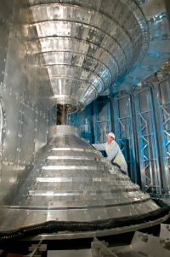
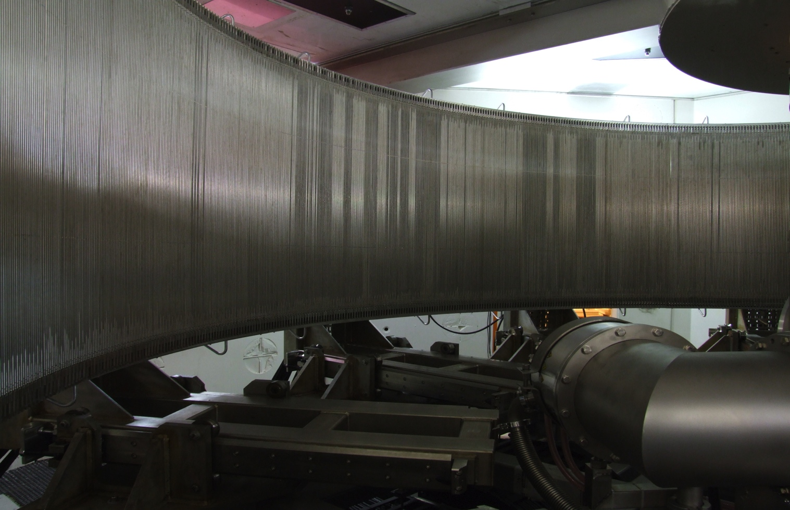
VATES : The problem
Highly pixelated instruments
Large data volumes
Many dimensions of interest
Need for n-dimensional data manipulation
One workbench required
760 tubes
x 128 pixels
x 5000 time channels =
450 Mb per run!
160º
+/- 15º

Slide 3
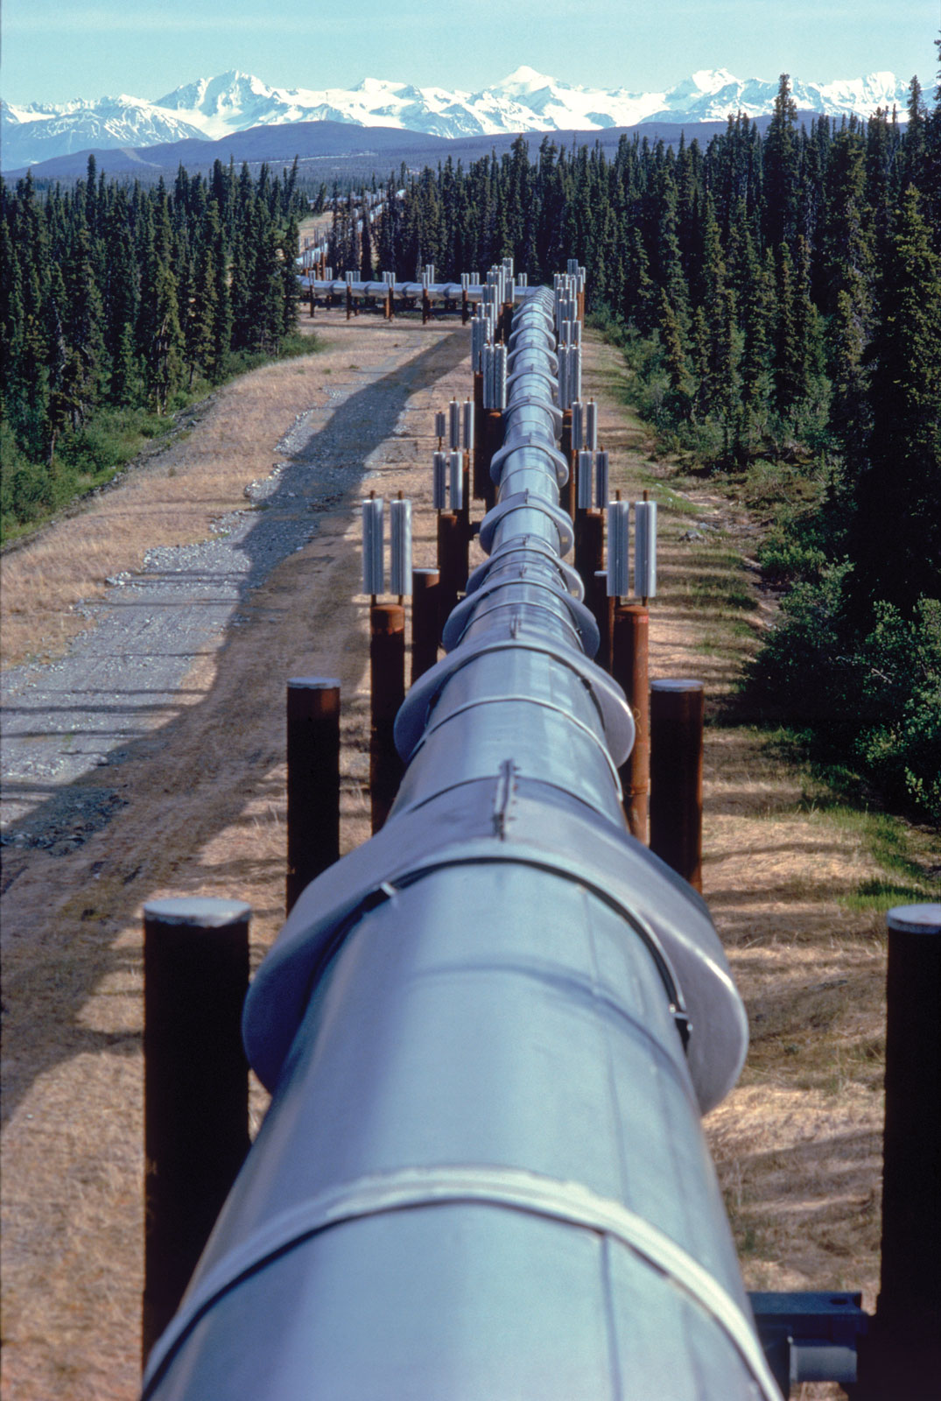
VATES : Requirements
Containers and pipeline for multi-dimensional data
Visualisation of multi-dimensional data
Simulation and fitting of multi-dimensional data
Pluggable/Extendable in many ways
Notes:
Containers and processing algorithmic steps are required for multidimensional data. We need flexibility both in terms of the dimensionality of the data, and the ability to change and adapt the pipelines we assemble.
We need the ability to both support Histogrammed data, and Sparse data effectively in a multidimensional format. We need the ability to easily perform common operations on the data, such as addition and subtraction, merging, rebinning etc.
We need the ability to visualize multidimensional data at any point, and also the ability to drive algorithmic steps in the visualisation mode in-situ.
We need the ability to simulate multidimensional data and to provide fitting features.
All this should work cross platform and be supported with regular releases.

Slide 4
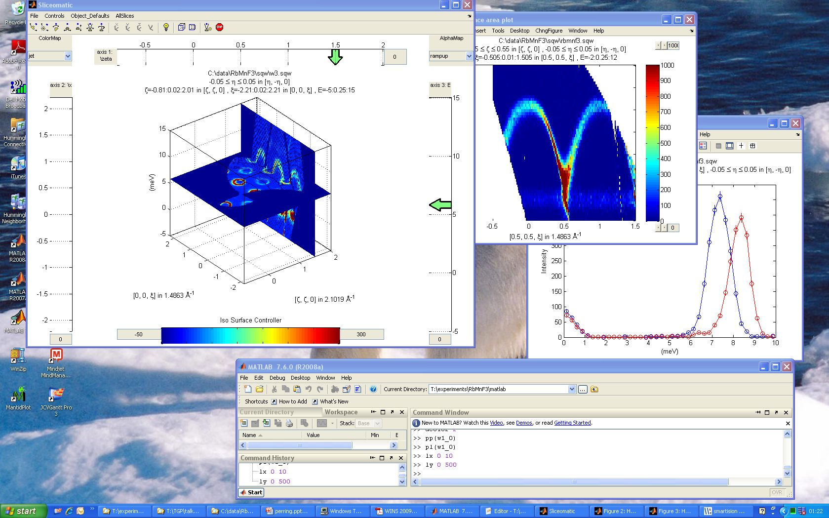
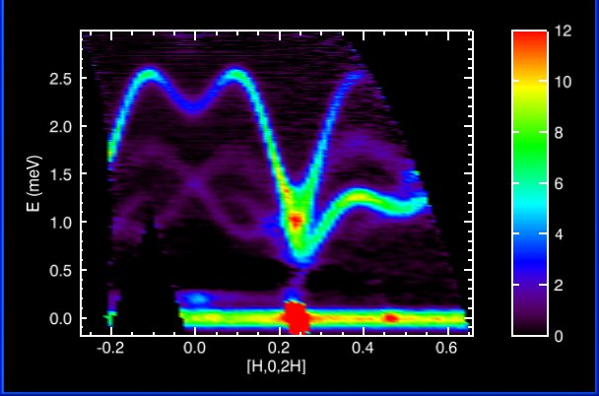
Previous and Existing Tools
Many successful tools to draw ideas from and extend
Notes:
The community has provided a lot of good and successful tools. Horace, Tobyfit, Mslice, Dave, Isaw and others have all been used to steer the development. We have also been fortunate enough to have input from some of the developers of these tools at various points in the project.

Slide 5
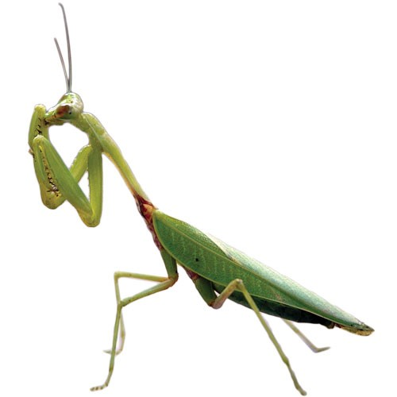
Platform Design Choice: Mantid
Mantid: Instrument and technique independent Data Reduction and Analysis.
Joint project by ISIS and SNS
Overlap in target platforms
Overlap in common functionality
Assemble one continuous chain
Shared maintenance effort
No need for another standalone tool
Notes:
Our primary design choice as a platform for the work has been Mantid.
Joint project that started running in 2007, with the SNS joining the collaboration in 2010.
The Mantid project was appealing particularly because:

Slide 6
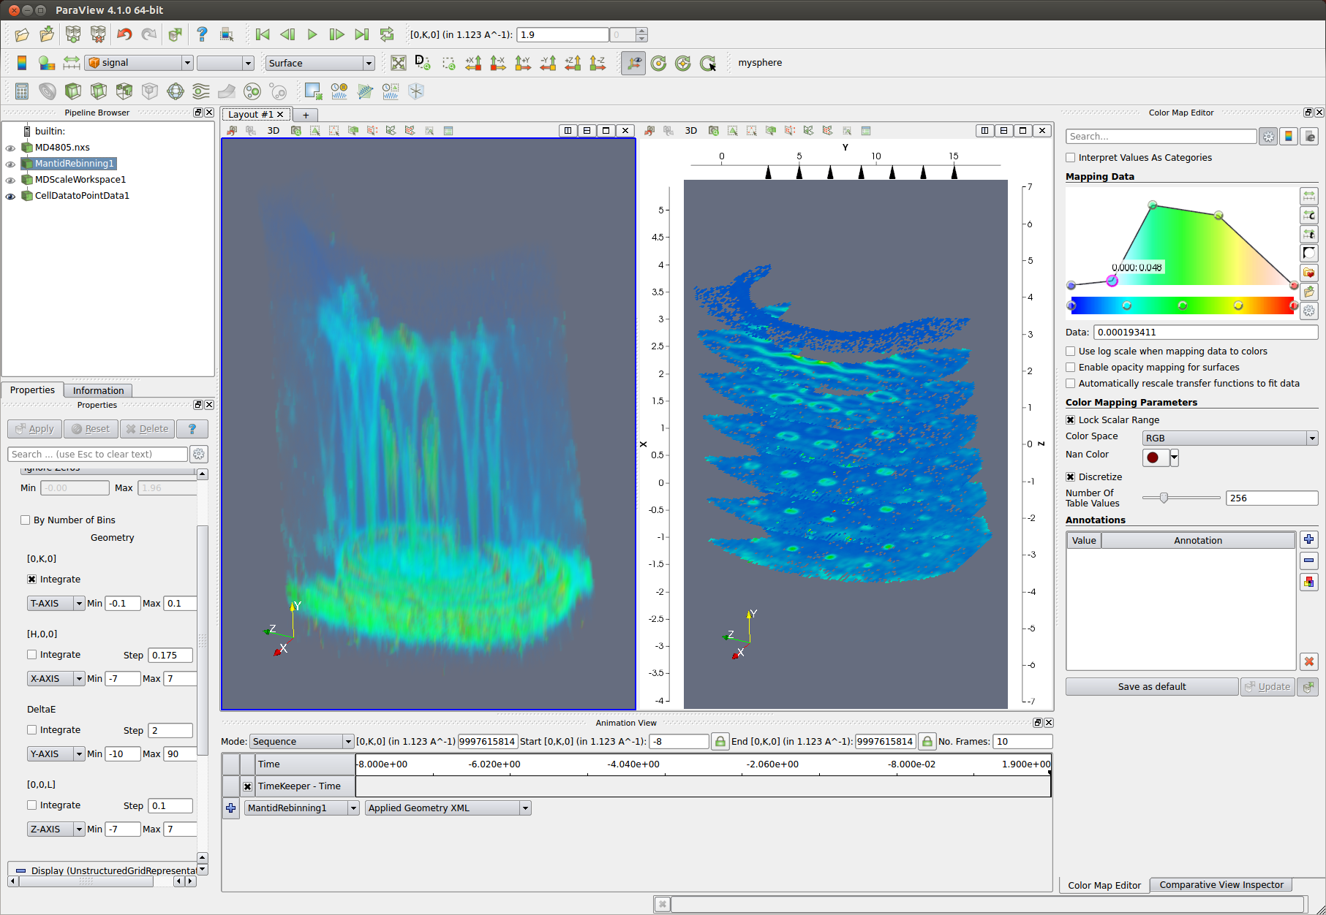
Platform Design Choice: ParaView
Cross-platform
Well supported
Open source
Pipeline branching
Suitable for large volumes of data
Notes:
Another design choice has been to use ParaView. ParaView is a mature technology that has been developed as a collaboration between KitWare, and various US national labs, such as Los Alamos and Sandia.
Has been used for visualizing terabytes of data
Very powerful user interface
Well supported.
Easily pluggable in terms of filters and loaders, but also
Options for customisation of the user interface itself.

Slide 7
Historic Overview
2010
2011
2012
Prototypes
Dynamic rebinning
Mantid
Release 2.2
2012
Binary MD algorithms
Visualisation driven on the fly rebinning
VATES as plugin installer
nD Data formats
VATES
nD Visualisation
Simple Vates GUI
Slice Viewer
Combine Packaging
Paraview-Mantid Plugins
Mantid
Notes:
This is a historic view of the project leading up to the last Nobugs meeting. I’ve selected a few important milestones to fit onto the timeline, such as the development of the 2D SliceViewer, and the introduction of Binary MD Algorithms.

Slide 8
Overview
2.3
2.4
2.5
2.6
3.0
3.1
3.2
2012
2013
2014
3D non-orthogonal projections
Stress testing
Peak Reporting
PSI & ILL involvement
Natural Coordinates
Optimization
VATES
Collaboration with Kitware
ParaView Upgrade
Scriptablity
MD Normalization …
VATES algorithms in Instrument View
nD Connected Component Labeling
PeaksViewer
Mantid
Fold project
SC reduction interface
Use the VSI for imaging
Notes:
And this is an overview of the project from the last no-bugs meeting to the present. Mantid and VATES are packaged together so the releases are identical. At the top we show the major releases of Mantid during that period. Again, I’ve added milestones for some of the important developments. You’ll see that there’s been a number of improvements and additions since the last time we met. I’ll be talking about some of these in more details.

Slide 9
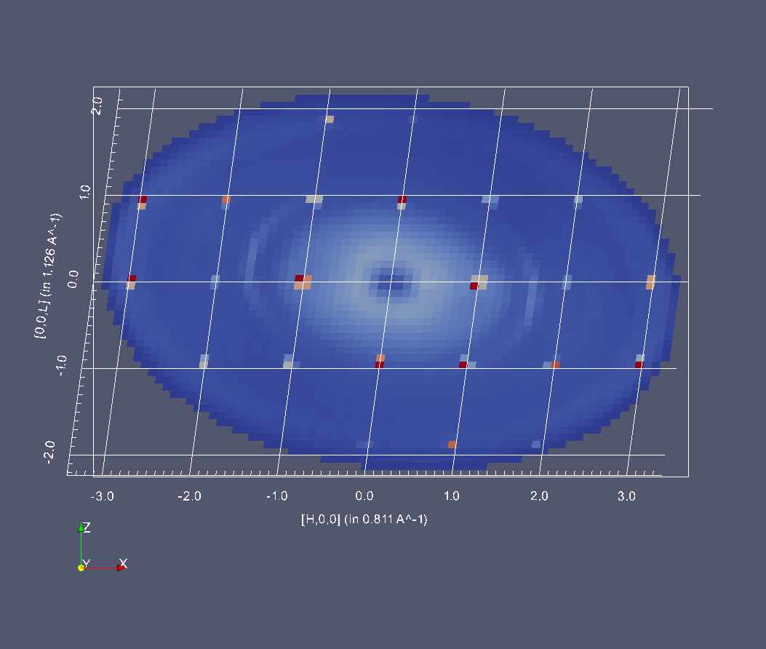
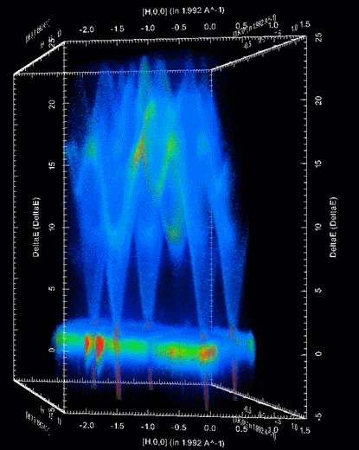
Non Orthogonal Projections
Notes:
We have built into the 3D visualisation the ability to switch between coordinate systems.
Quite a bit of work on the part of both Kitware and our team to achieve this. This was done as part of a larger piece of work, that involved us passing on some of our home-grown features to ParaView, as well as a number of changes on their side to improve the flexibility of some of their representations.
The B matrix is used to provide the transform from triclinic to orthonormal.
Figure 1: Br_PHCX_75_E0 measured where?
Figure 2: A non-orthogonal 3D projection of Spin Waves in Gd as measured on SEQUOIA.

Slide 10
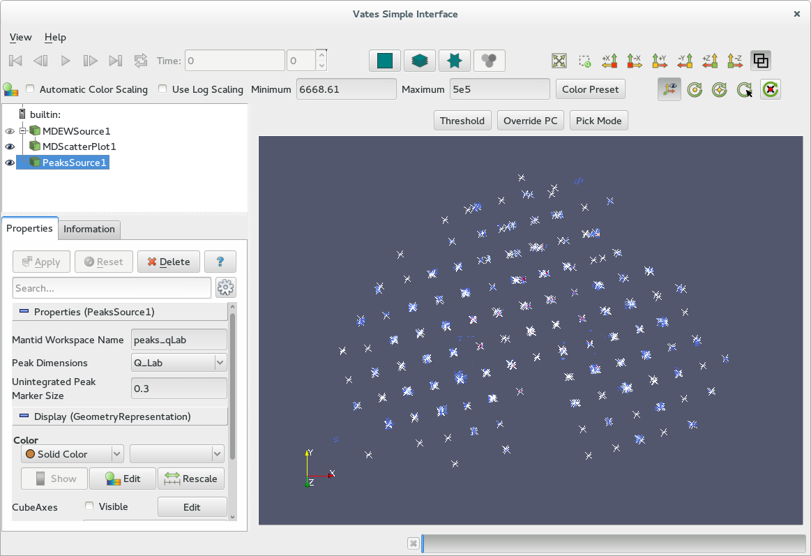
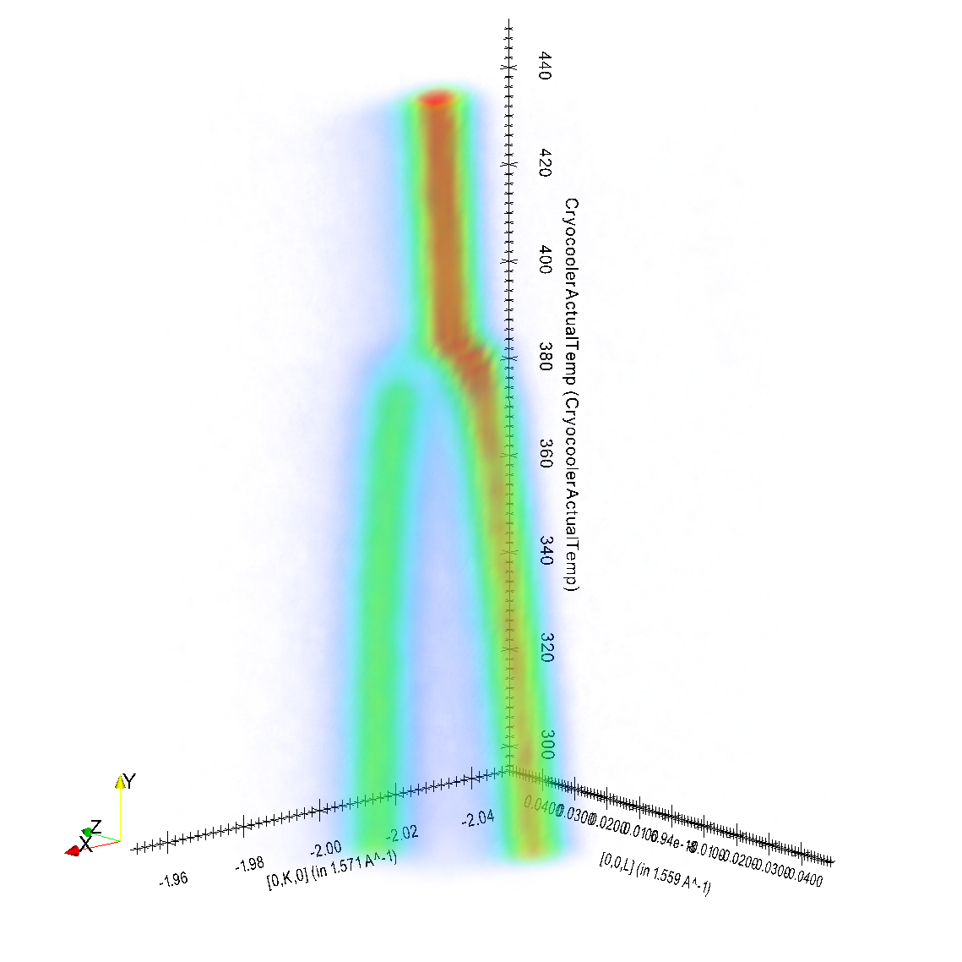
Notes:
Sodium chloride sample on SXD with overlayed SCD peak posiitons, automatically found via algorithms projected over the top of the data.
‘Tuning fork’ Phase transition. From data collected on TOPAZ.

Slide 11
MD Normalization

Slide 12
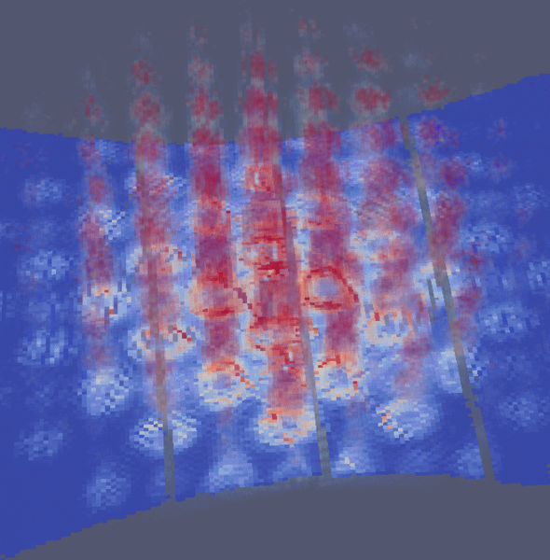
TobyFit
Simulation of MERLIN instrument resolution convolved with a Strontrium122 foreground model
Simulation of MERLIN instrument resolution convolved with a Strontrium122 foreground model using Mantid. Visualised using our ParaView plugins combining volumentric plot with a 2D projection.
Simulation of MERLIN instrument resolution convolved with a Strontrium122 foreground model using Mantid. Visualised using our ParaView plugins combining volumentric plot with a 2D projection.
Simulation of MERLIN instrument resolution convolved with a Strontrium122 foreground model using Mantid. Visualised using our ParaView plugins combining volumentric plot with a 2D projection.
Simulation of MERLIN instrument resolution convolved with a Strontrium122 foreground model using Mantid. Visualised using our ParaView plugins combining volumentric plot with a 2D projection.
Simulation of MERLIN instrument resolution convolved with a Strontrium122 foreground model using Mantid. Visualised using our ParaView plugins combining volumentric plot with a 2D projection.
Simulation of MERLIN instrument resolution convolved with a Strontrium122 foreground model using Mantid. Visualised using our ParaView plugins combining volumentric plot with a 2D projection.
Notes:
Simulation of MERLIN instrument resolution convolved with a Strontrium122 foreground model using Mantid. Visualised using our ParaView plugins combining volumentric plot with a 2D projection

Slide 13
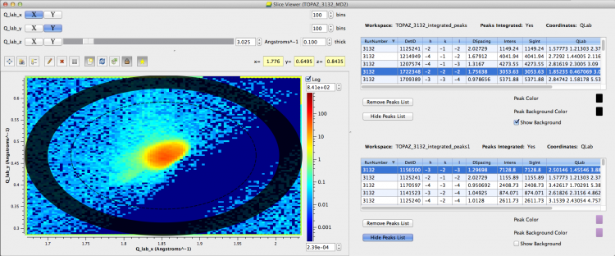
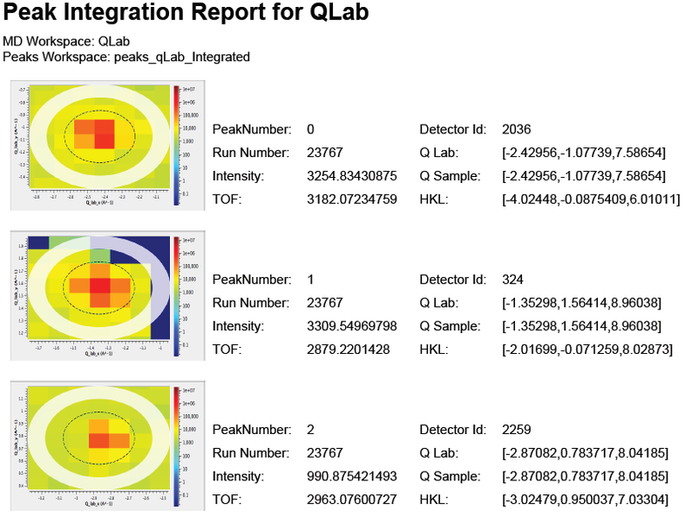
PeaksViewer
Notes:
Problem
Solution
Scriptability
PeaksReport
Video
(Future – defer till end)

Slide 14

PeaksViewer

Slide 15
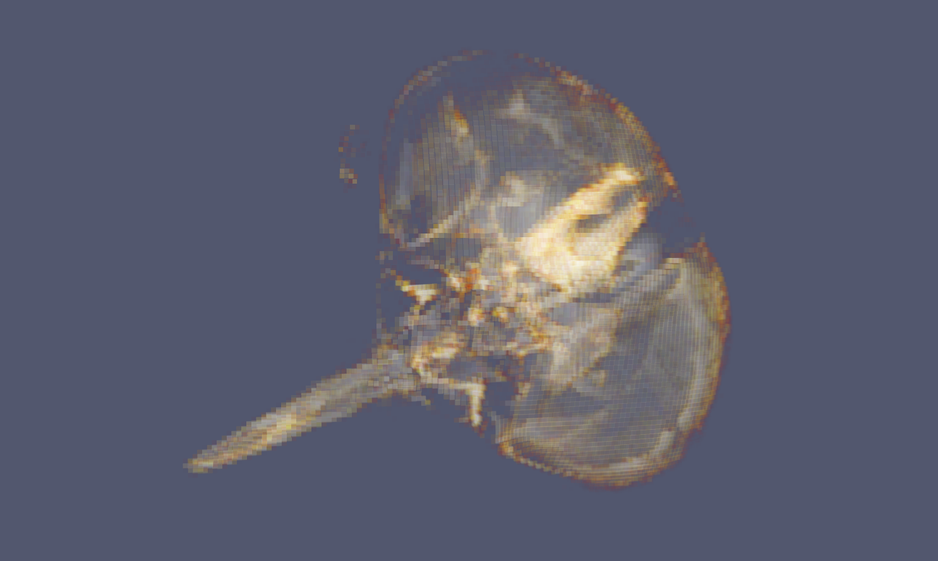
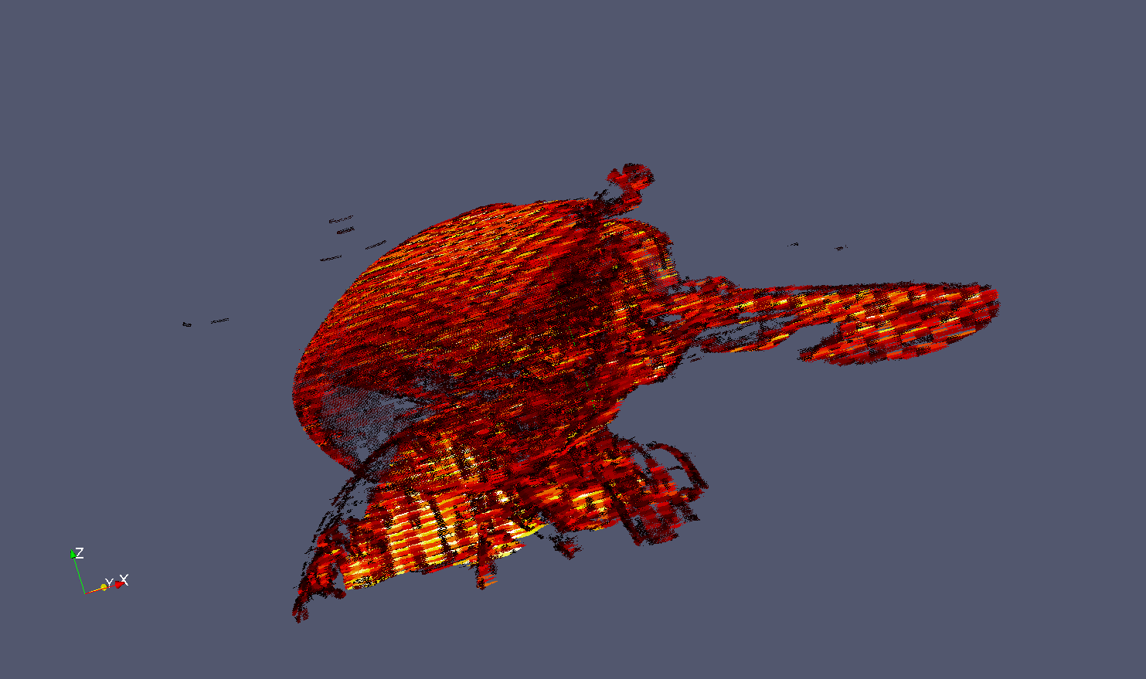
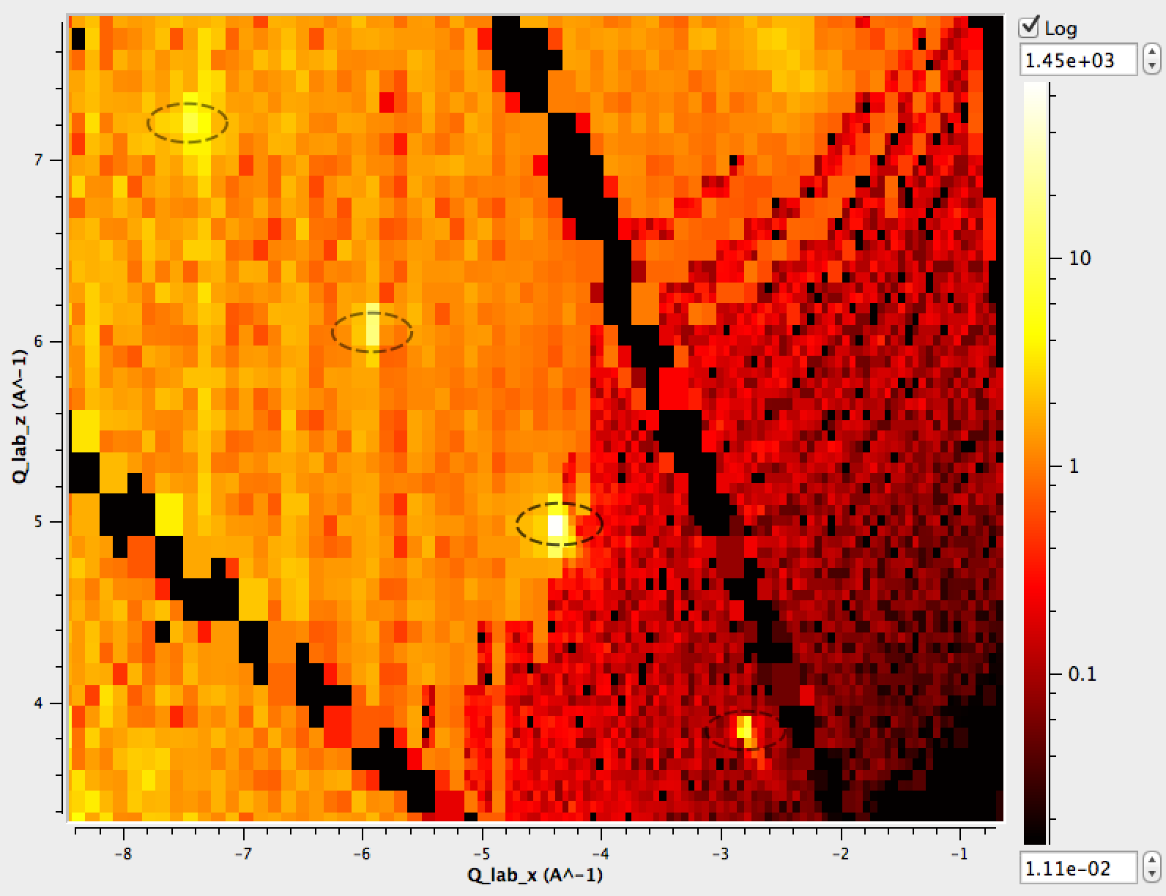
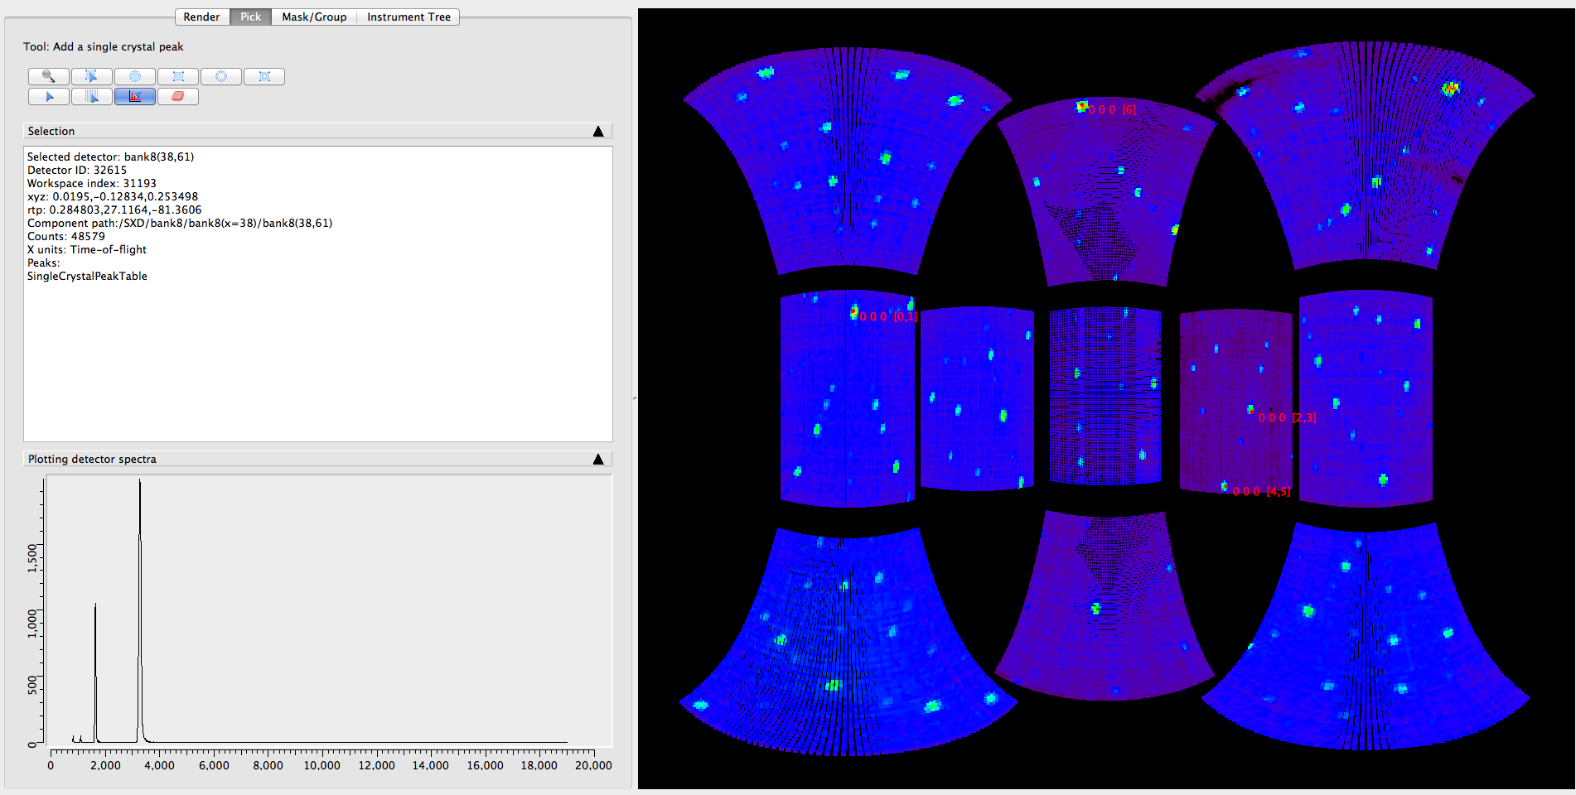
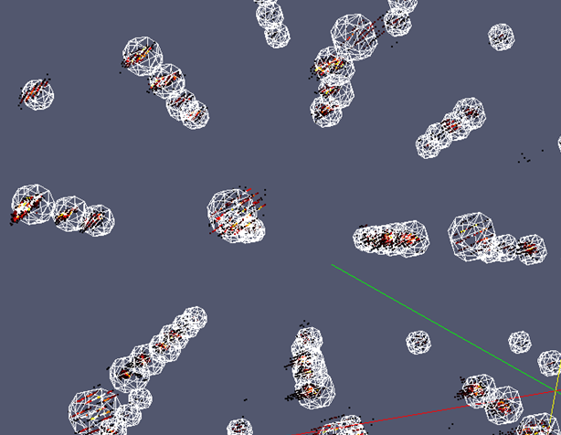
Two way interaction
Left: Slice through an multi-dimensional workspace in Q-lab. Algorithmic output fed into visualisation to show spherically integrated regions. Right: 3D representation of integration regions with Bragg peaks in Qlab. Both from cublic NaCl on SXD.
Notes:
Fly head
Instrument view using MD Algorithms
QueryMDWorkspace
plotMD
PSI using Mantid
Connected Component Analysis

Slide 16
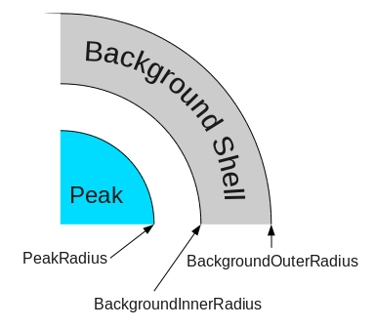
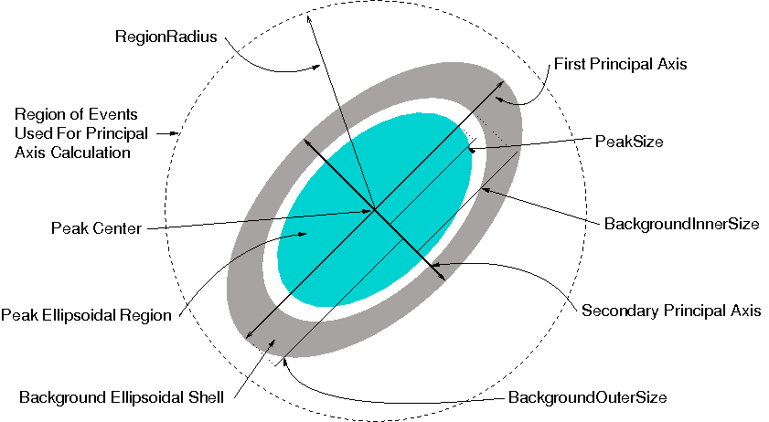
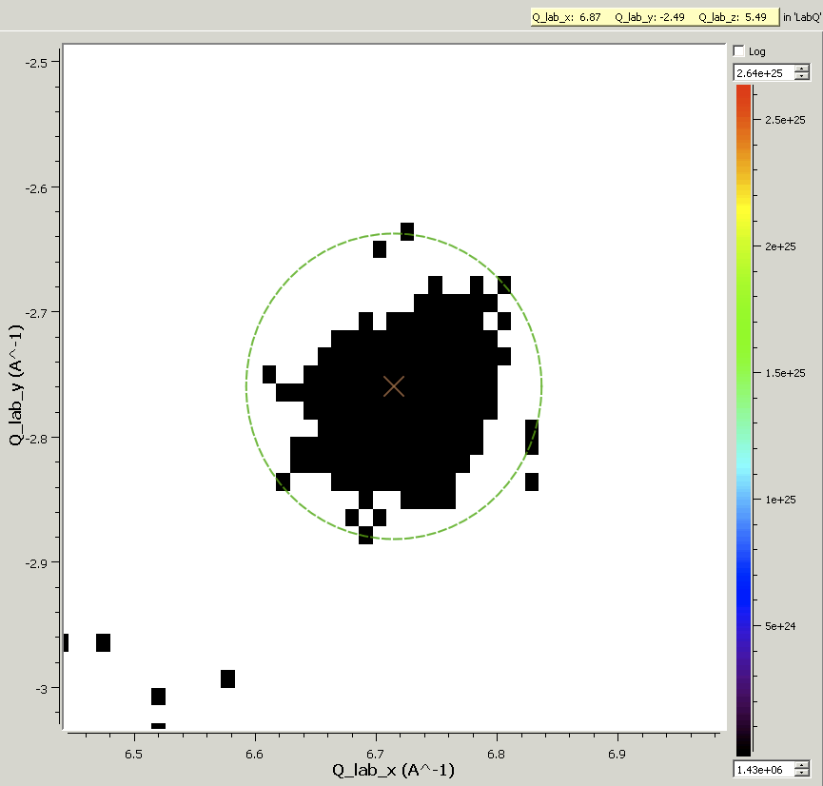
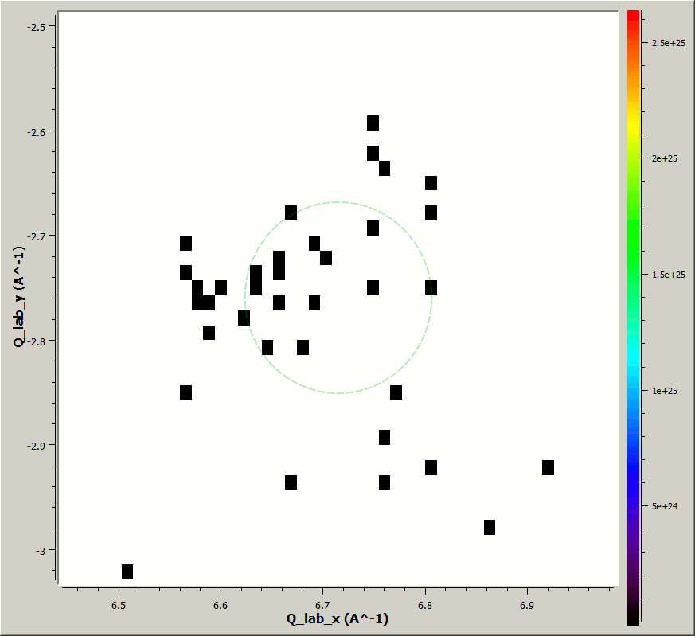
Peak Integration
Heavily uses both Mantid and VATES
Started out with a spherical integration algorithm
Ellipsoid integration
Experimenting with CCL approach
Notes:
Interesting test case.
Subject to a lot of interest by instrument scientists
Lots of possible ways of doing this
Inherent problem with determining peak shape
LC at ILL suggested using CCL
Implemented nD CCL (lean on the MDHistoWorkspace)
Implemented multi threaded CCL (lean on the MDHistoWorkspace)
First attempt, then most recent attempt. Still exploratory.

Slide 17
Things that have worked well
Drawing requirements from more than one facility
Having developers working on the project at each facility
Leaning on, and adding to an existing framework
Decoupling the visualisation from the algorithmic/execution layer
Continuous integration with regular releases
Solving deployment issues early
Notes:
By far the greatest and most important contribution to this project has been our collaborating scientists, who have made this project a success and prevented it from becoming a colossal waste of money. I cannot emphasise how vital this level of input is, and therefore how important it is as a development team to ensure that that information is acted upon quickly.
We have been fortunate enough to have a flow of requirements from two independent facilites. This has made it easier to provide many correct, widely applicable implementation, rather than ad-hoc features that fit for one group and one facility.
Starting from scratch is often a ruinous mistake. Building VATES on-top of Mantid meant that the team was almost immediately productive in creating new features.
Decoupling the visualisation layer from the algorithmic, execution layer has had too major advantages. Firstly, it made it possible to switch visualisation vendor with a few days worth of effort rather than a few months. Secondly it made it possible to test and develop the logic of the visualisation-driving layer using standard unit-testing techniques.
Linking on somewhat from the previous point. The VATES tools are incorporated into our continuous integration set-up. This helps ensure that the tools can always be built on our target platforms, that it is functionally doing the right thing, and that it can always be packaged on each of those plaforms. Regular releases have been critical in allowing our users to try the tools out and provide feeback.
In order to take advantage of the previous, it was vital that the VATES tools were moved from development-prototype into something that could be installed and executed by our users easily. We therefore pushed solving deployment to the top of our to do list.

Slide 18
Things we could have done better
Close collaboration with the users (better two way interaction) (I’m a software engineer, not a neutron scientist).
Building the 2D Visualisation before the 3D Visualisation
Scriptability considerations first.
Dedicated resources
Notes:
No room for complacency here. There have been occasions where new features did not meet the users expectations. More often than not, these issues could have been stamped-out much earlier. For example, we did not appreciate how intuitive the 3D visualisation tools would need to be during our first iteration.
We should have envisioned the simplest visualisation usage scenario before the more complex one.
Users rightly get annoyed, when things suddenly stop working as they should. Although we like to think such scenarios are rare, when they do occur, they usually could have been avoided outright if we had proper automated test coverage for that functionality.

Slide 19
Looking Forwards
Complete scriptability. A well thought out API.
Better cohesion between tools.
MD normalization work.
Processing of large datafiles.
Turning our attention to MPI and GPU processing
Continued scientific led development
Notes:
Dump output of peak finding onto workspace, then move around in 3D to see how well its done.
Input from all directions whole other stories:
Dennis M. and peak searching
Horace
:
Hot off the presss: Md workspaces can be exported as numpy arrays (and v.v.)

